Slide 1
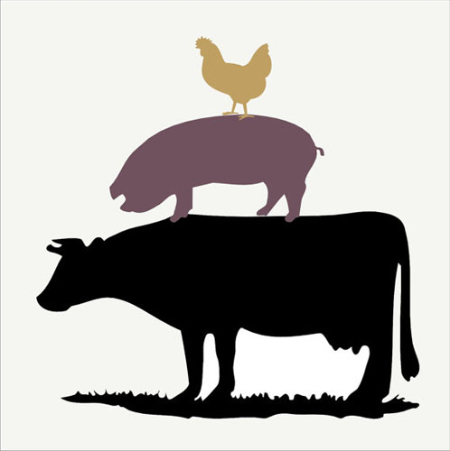
Animal Disease Analysis
Allison Beatty
Ian Scarff

Slide 2
Data Description
Incidents of disease in animals
17,000 observations
EMPRES (Emergency Prevention System) Global Animal Disease Information System.
Food and Agriculture Organization of the United Nations
Via Kaggle

Slide 3
Information in Data
Location
Location Quality
Date
Status
Disease & Serotypes
Species Description
Number At Risk
Number of Cases & Deaths
Number of Humans Affected & Human Deaths.

Slide 4
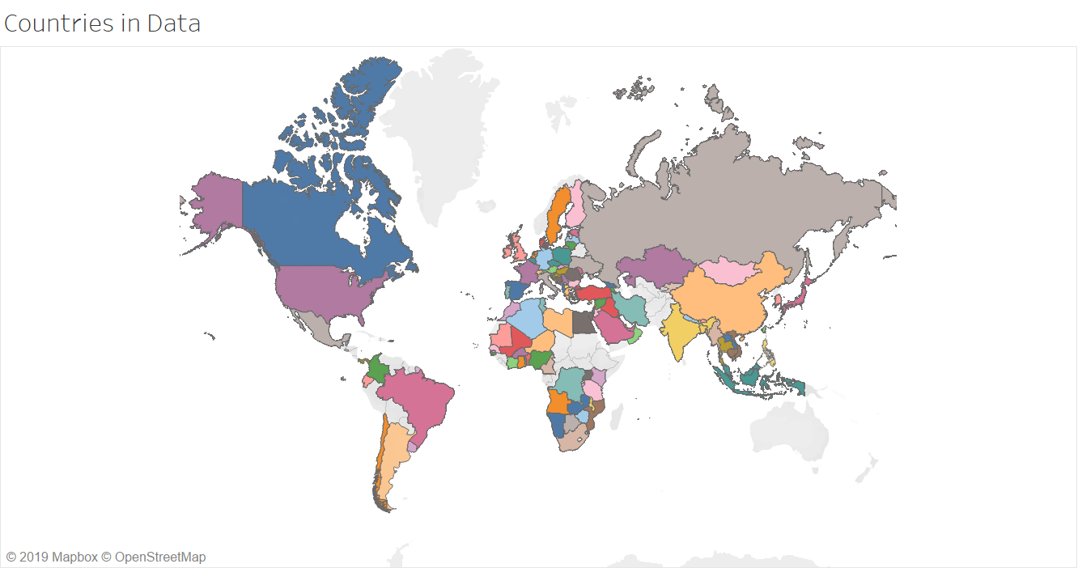
Location
Latitude, Longitude, Continent, Country, Administrative Region, Locality

Slide 5
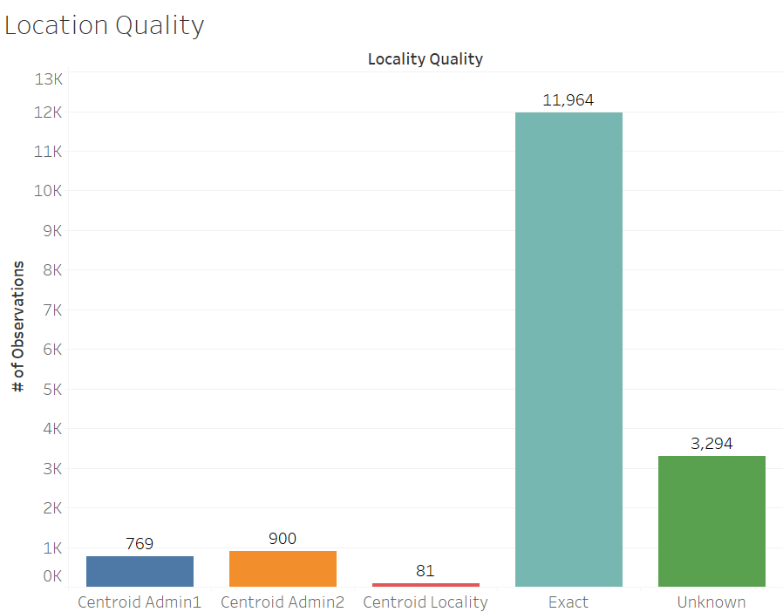
Location Quality

Slide 6
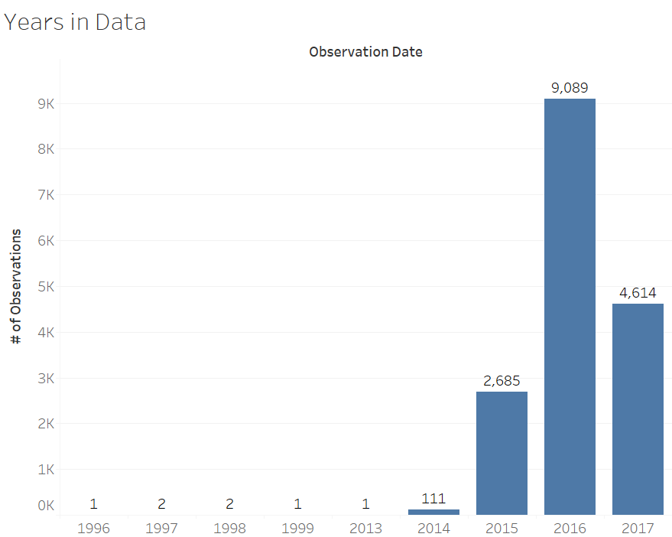
Date

Slide 7
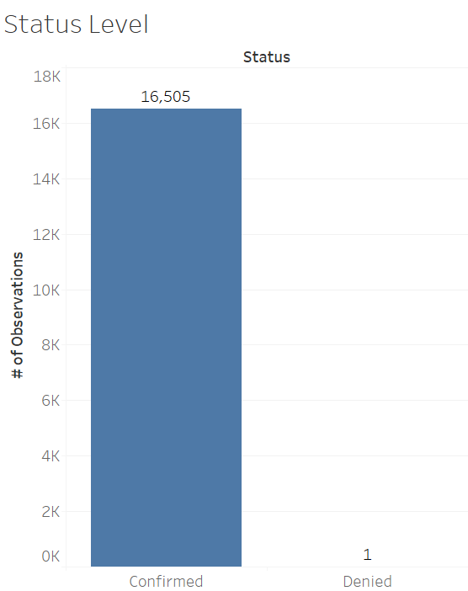
Status

Slide 8
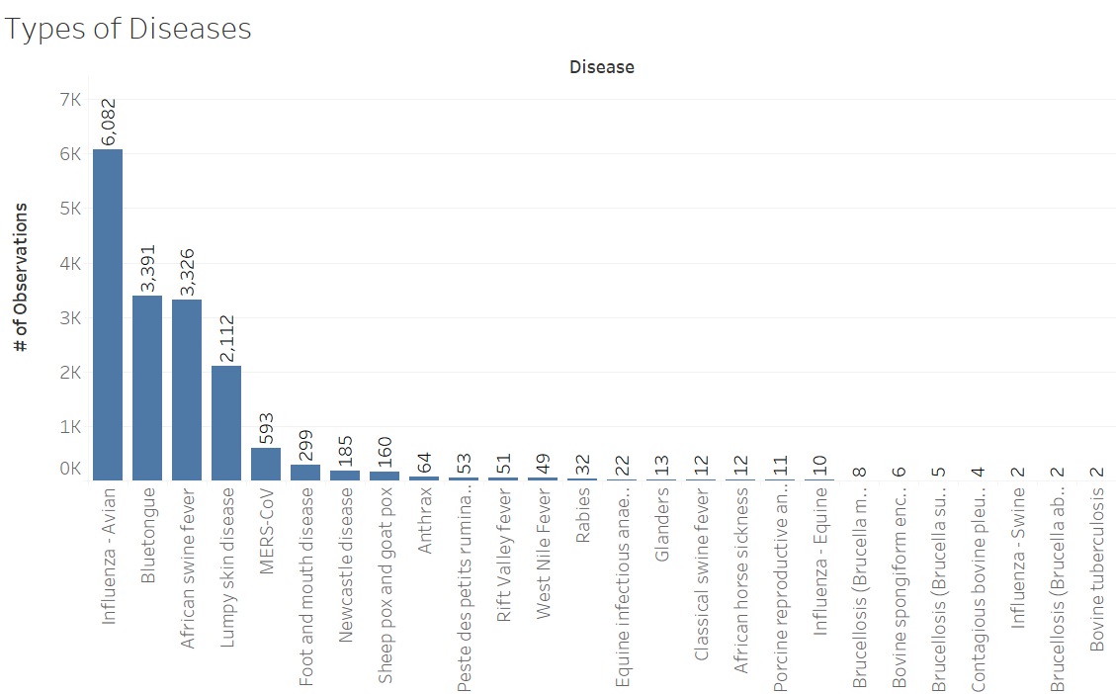
Disease & Serotype

Slide 9
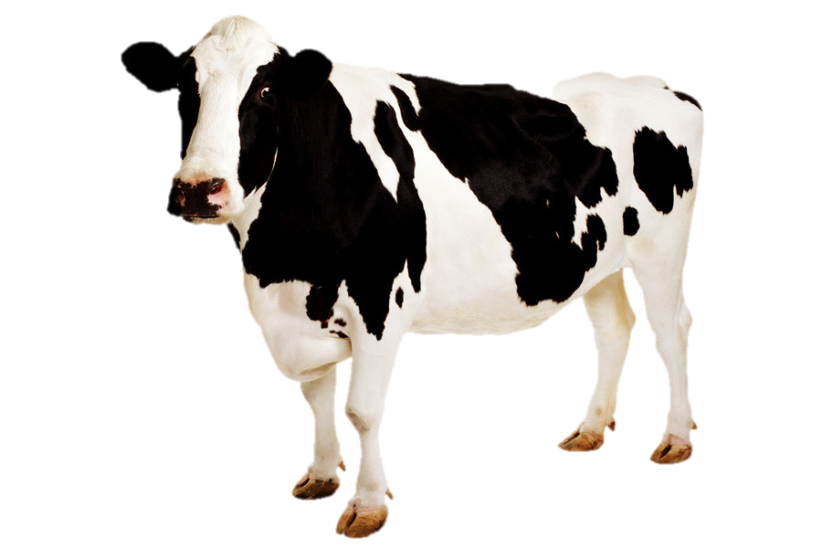
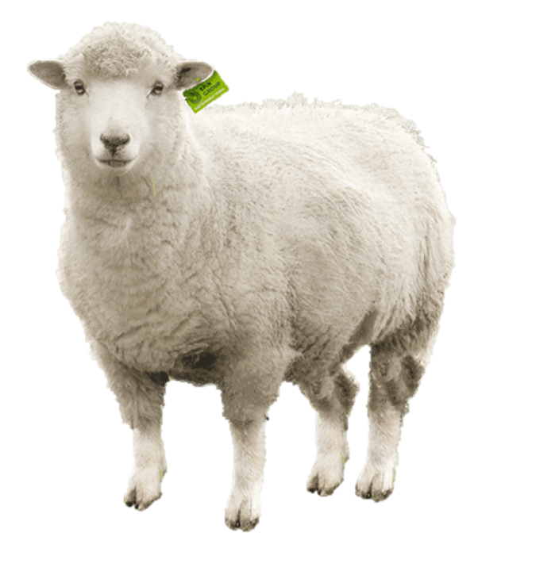
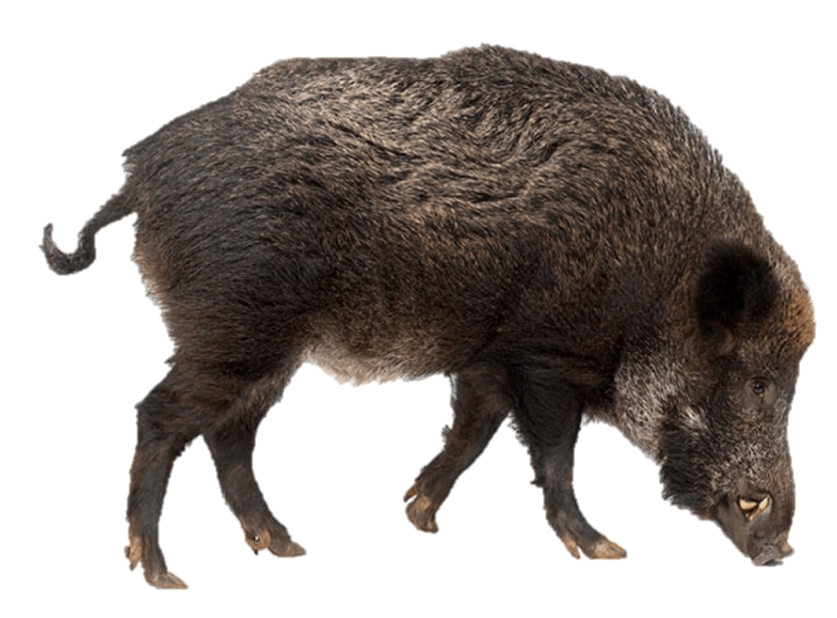
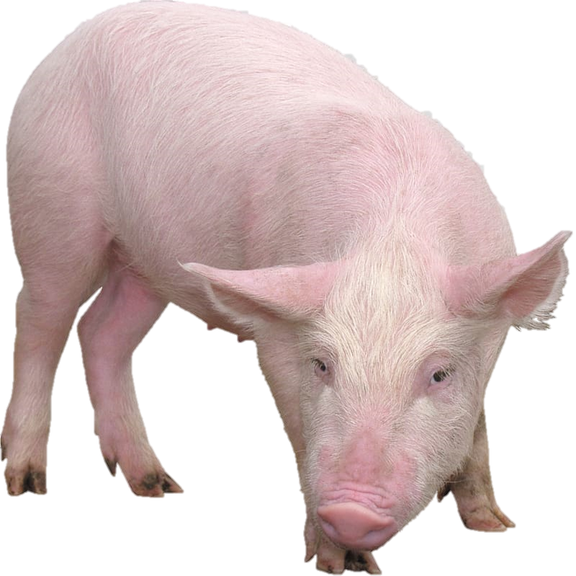

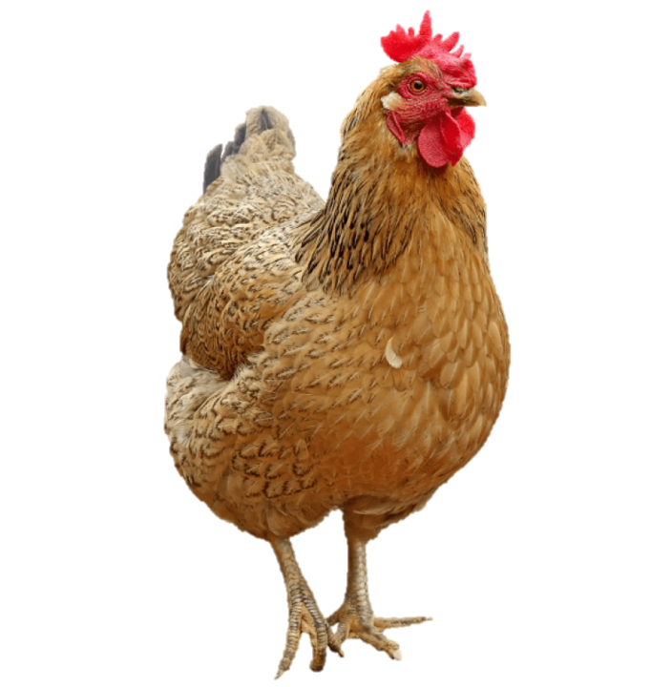
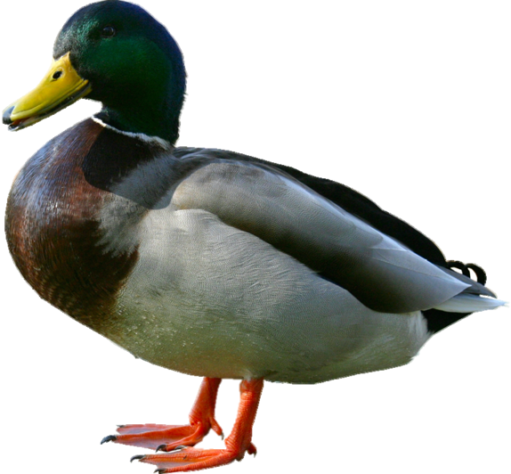
Species Description
Summarized by main animals.
?

Slide 10
Information in Data Cont.
Number At Risk
Sum of animal population at risk of contracting disease
Number of Cases
The number of animals that got infected
Number of Deaths
The number of animals that died from disease
Number of Humans Affected & Human Deaths
Add-On Variables:
Month, Year, Season (Based on Latitude), and Main Animal

Slide 11
Data of Interest
Exact location quality
Years 2015, 2016, and 2017
Confirmed Status

Slide 12
Focus of Analysis
What are the most prevalent animal diseases?
What countries are most at risk for these types of diseases?
Are these diseases harmful to humans?
Which animal (domestic, wild, or captive) poses the greatest risk of spreading these diseases?

Slide 13
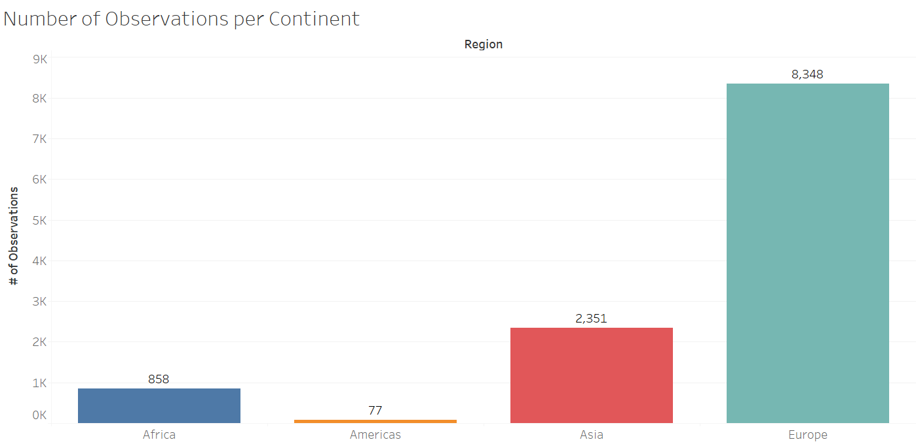

Slide 14
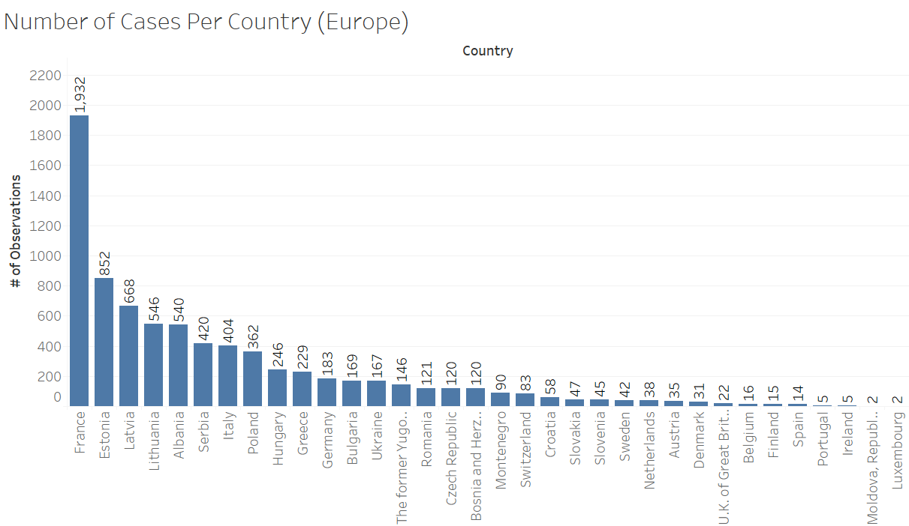

Slide 15
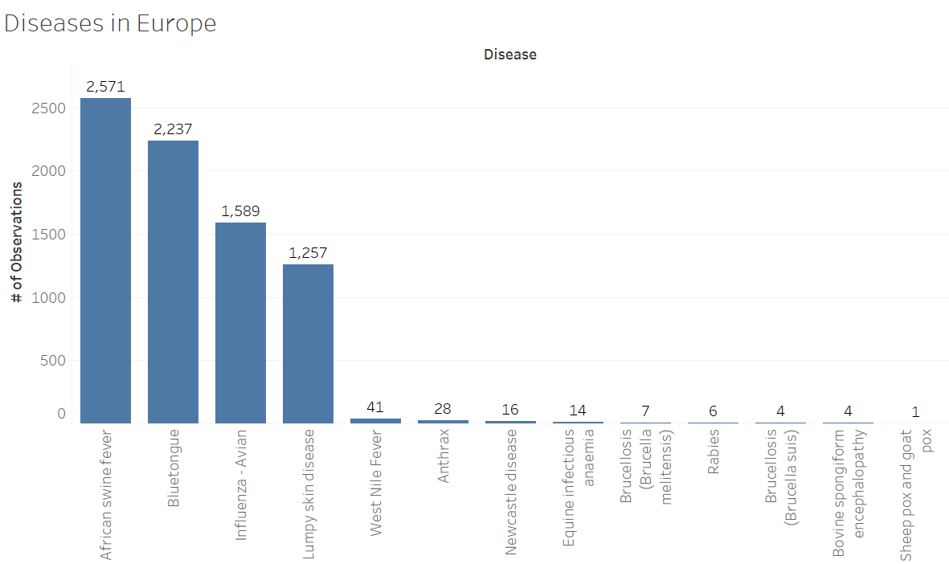

Slide 16
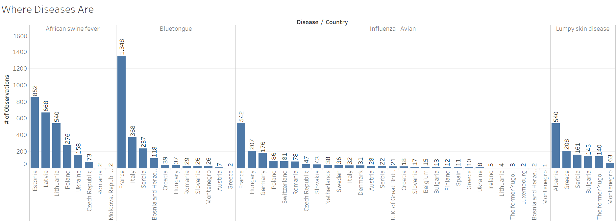

Slide 17
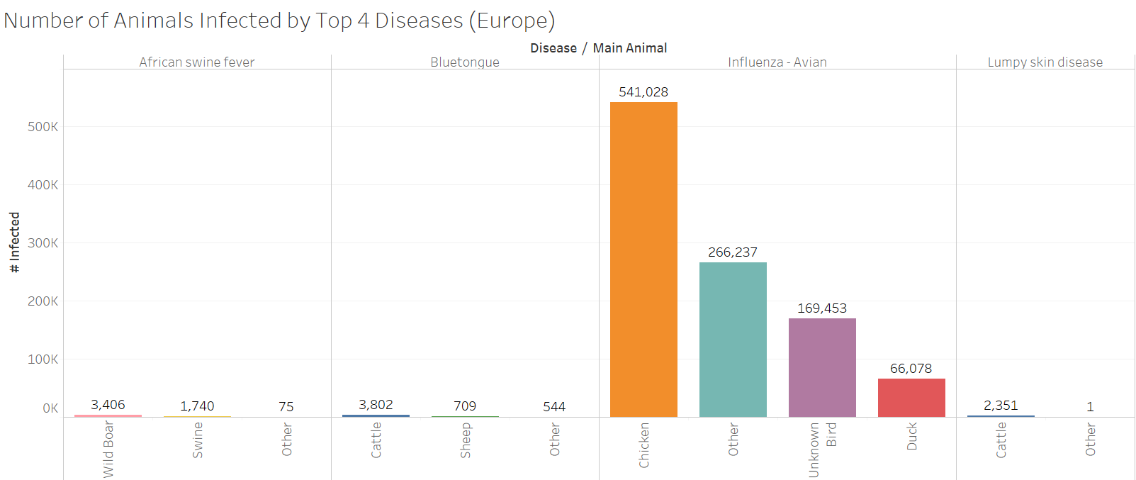

Slide 18
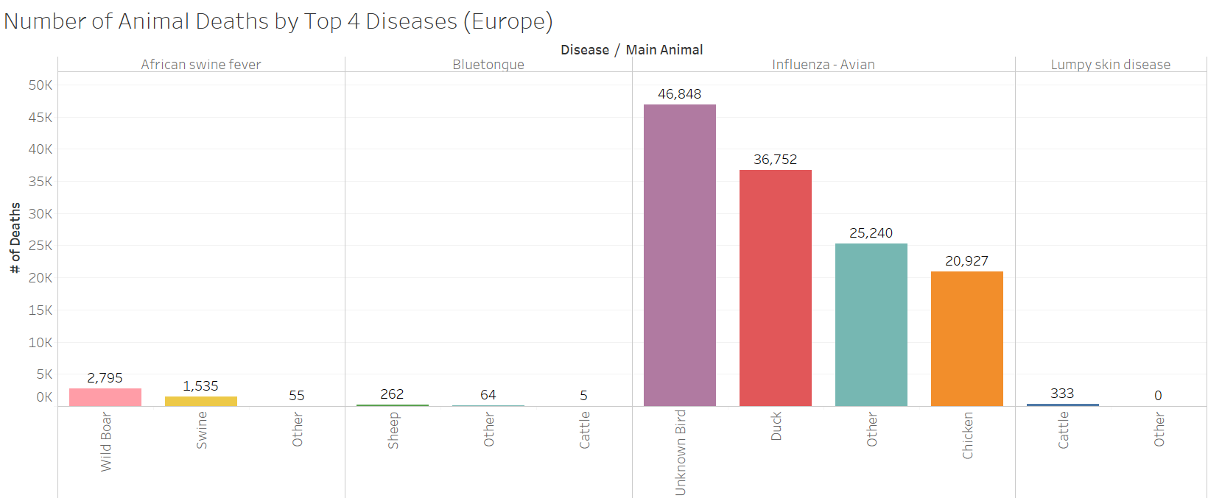

Slide 19
Go to Maps

Slide 20
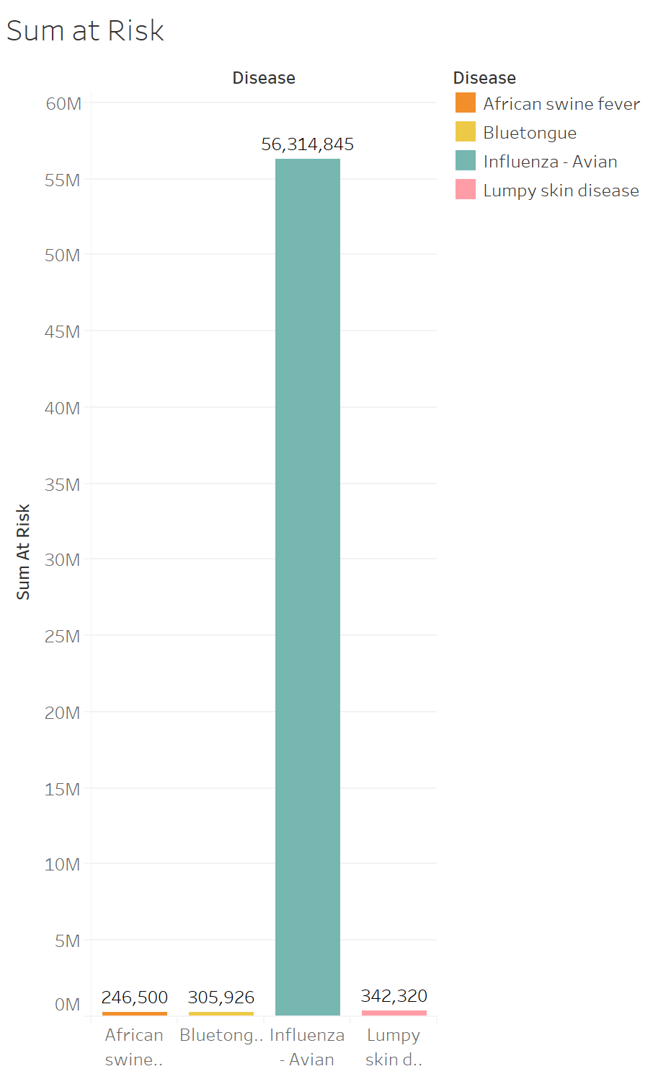
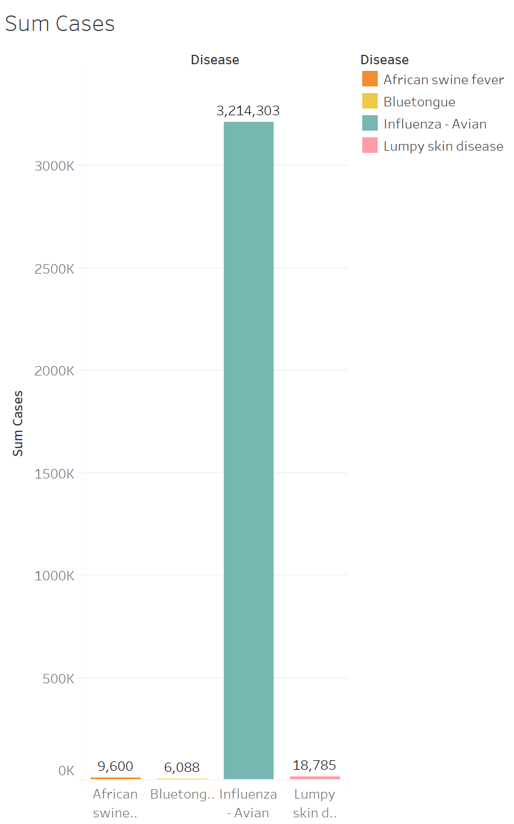
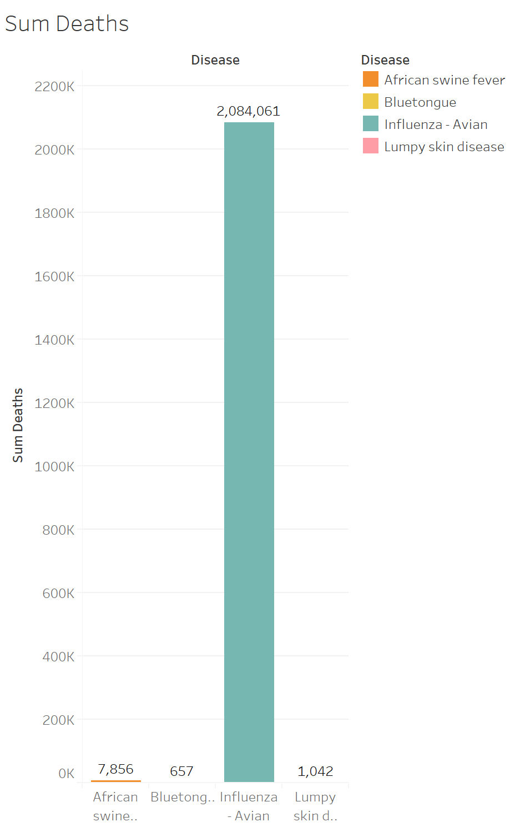
Top Four Most Prevalent Animal Diseases

Slide 21
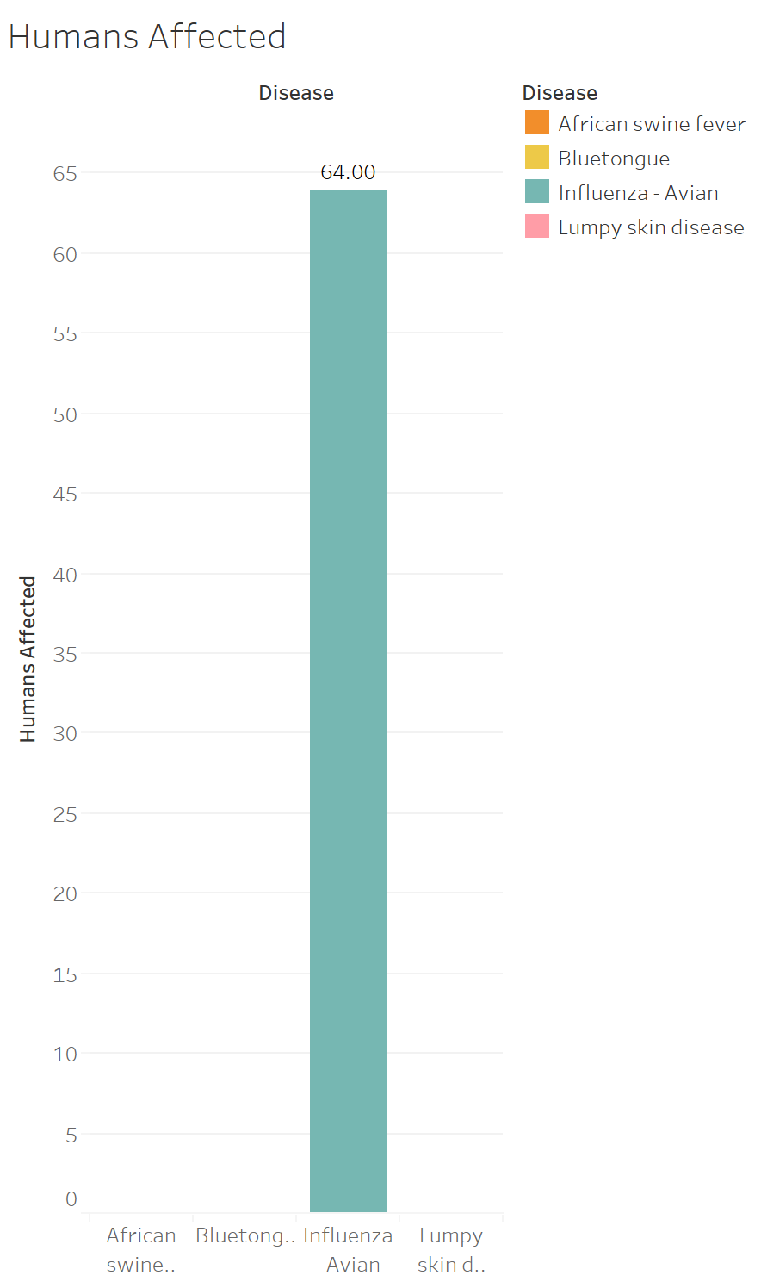

Harmful to Humans?

Slide 22
Harmful to Humans?
Influenza-Avian: Fatalities are rare, but certain strains of Avian Flu can be transmitted to humans. According to the World Health Organization, most cases of Avian Flu in humans are caused by coming in direct contact with an infected animal - dead or alive.
African Swine Fever: Cannot be transferred to humans.
Bluetongue: Cannot be transferred to humans.
Lumpy Skin Disease: Cannot be transferred to humans.

Slide 23
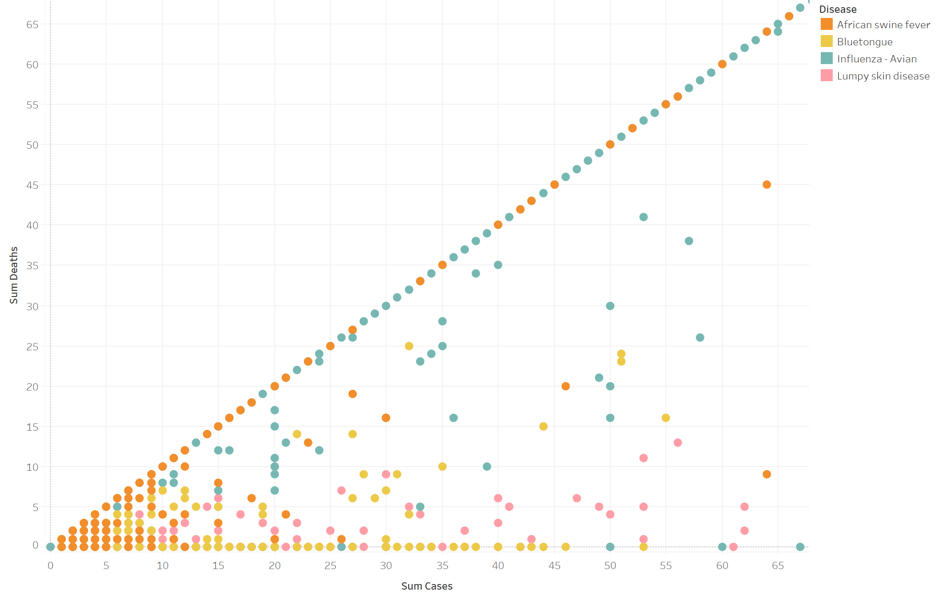
Impact on Animals
For most outbreaks, there were minimal deaths.

Slide 24
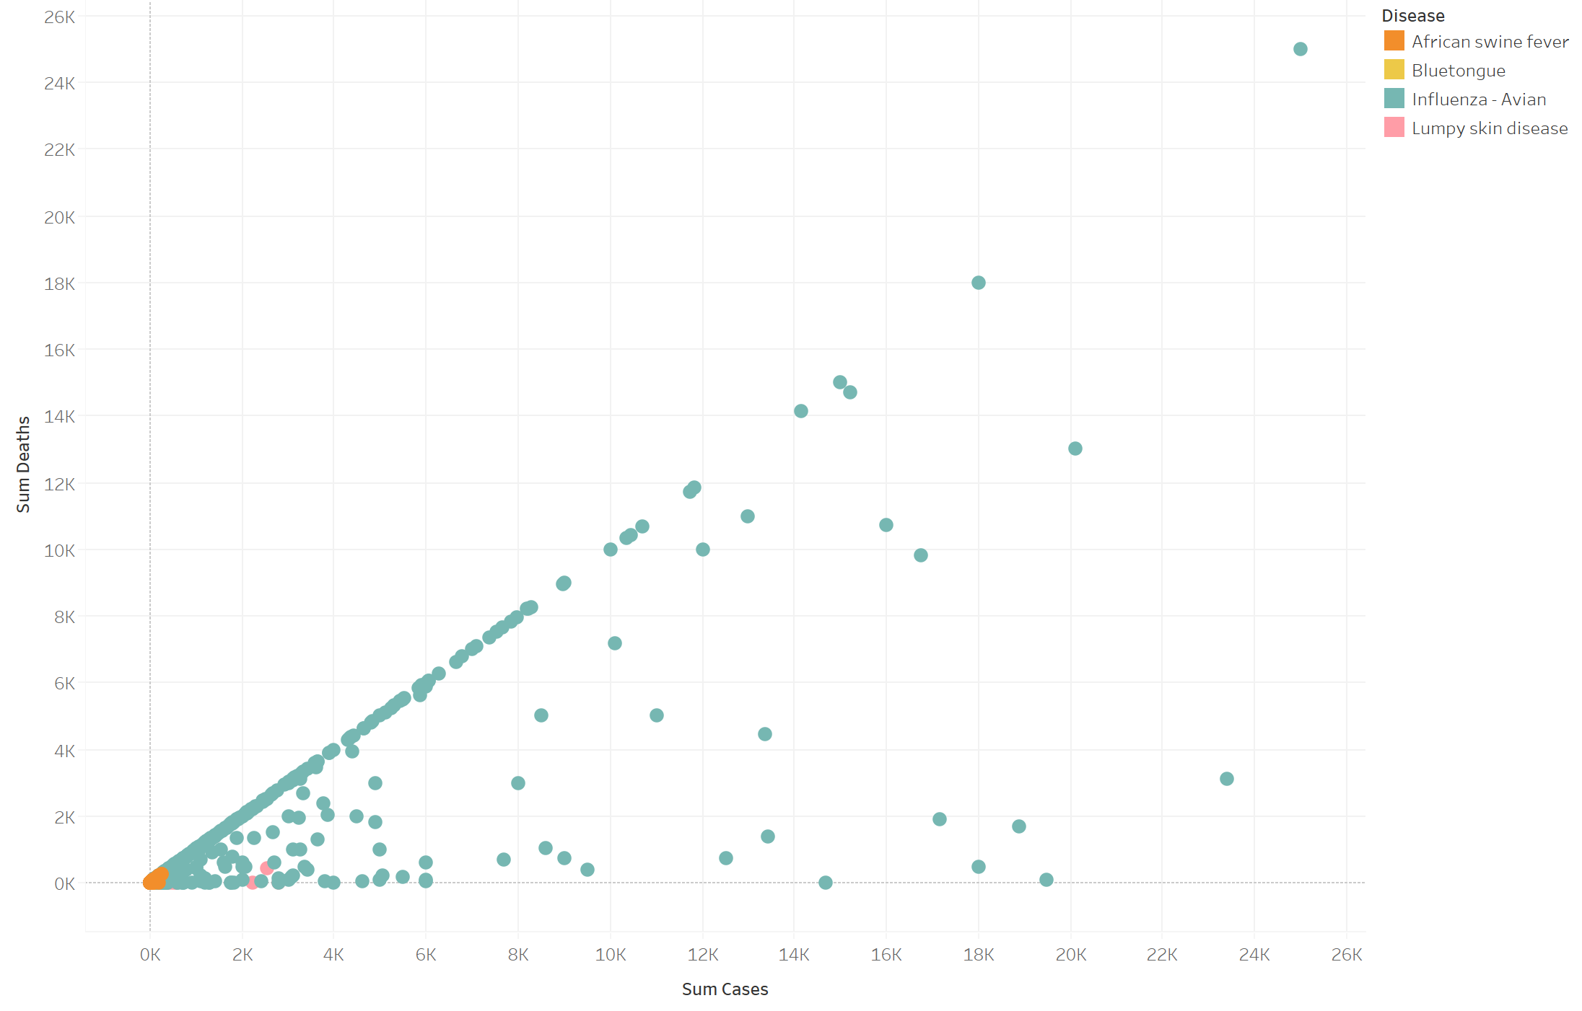
Impact on Animals
However, a few of these outbreaks have resulted in significant loss of life.

Slide 25
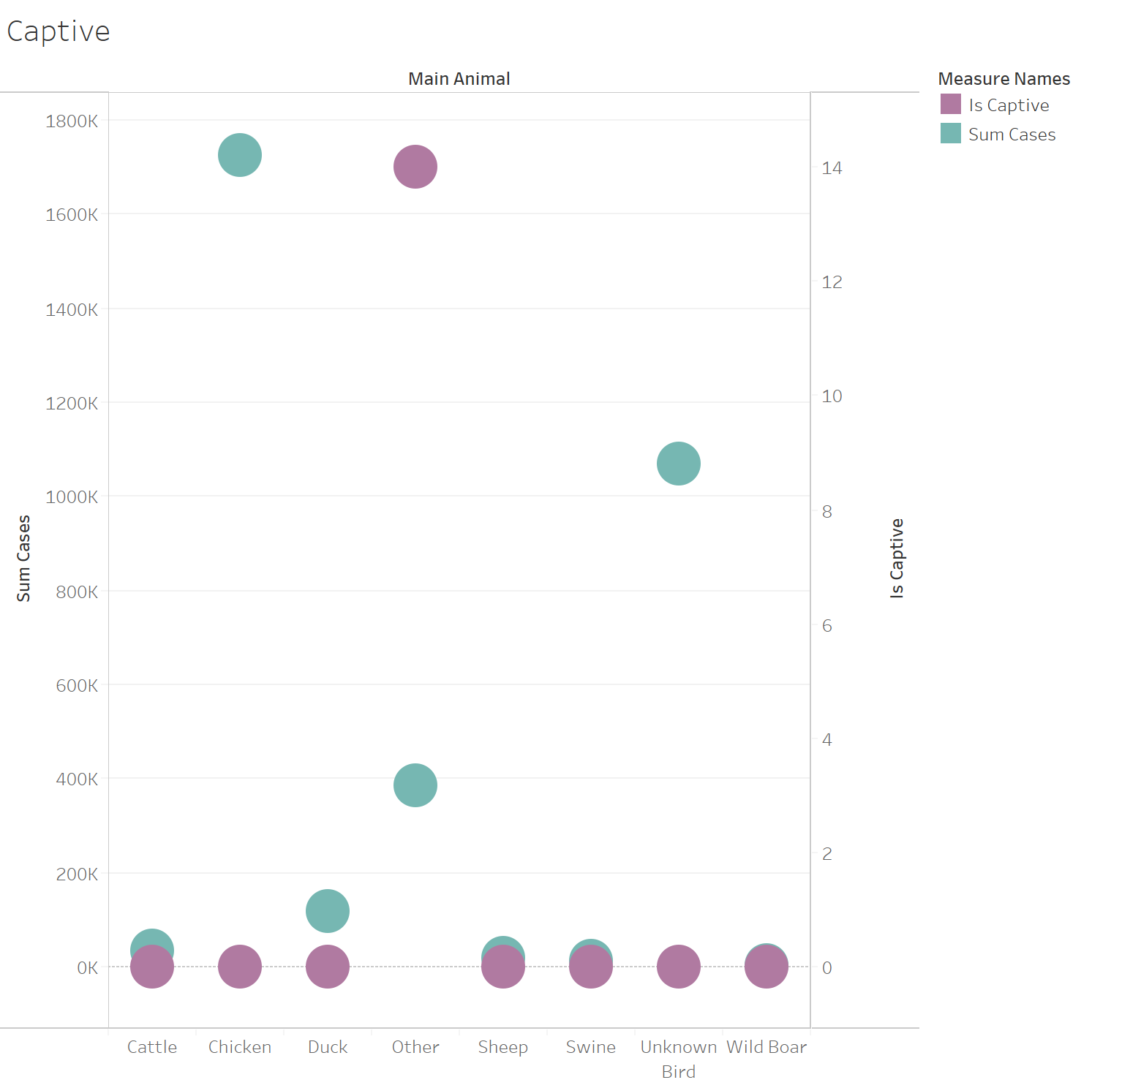
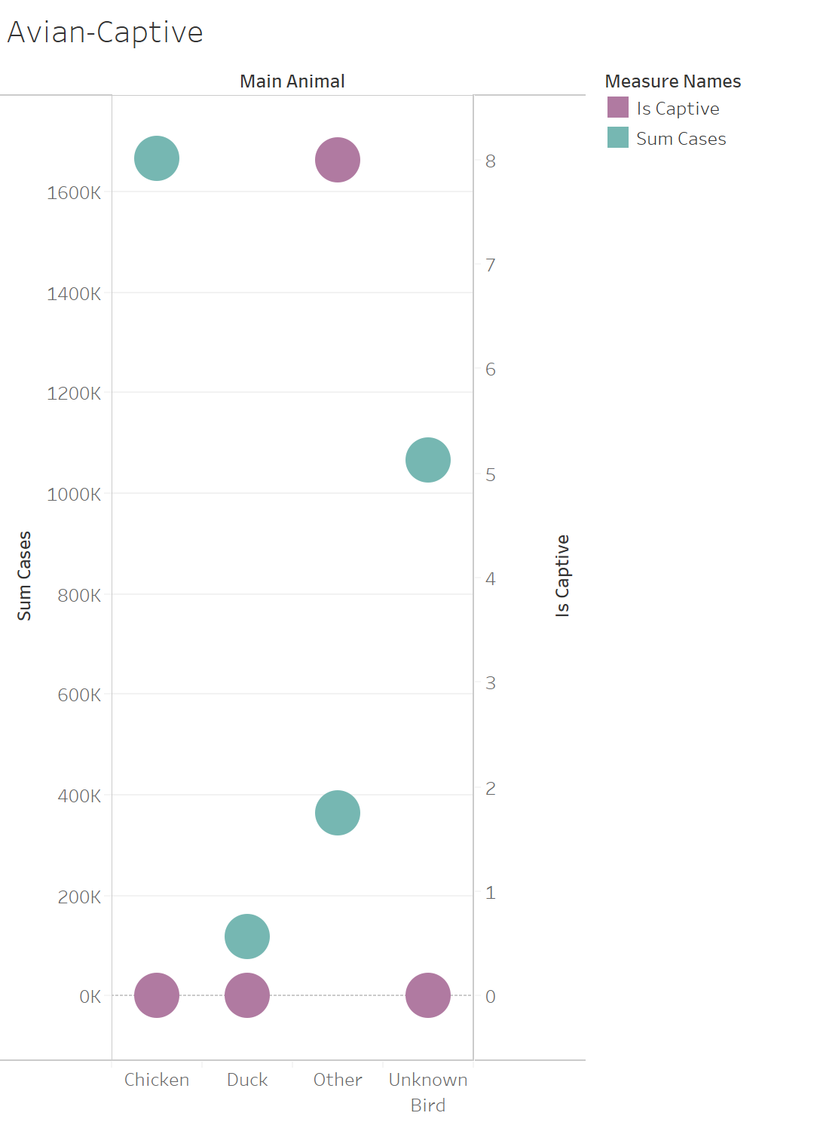
Which Animal Will Spread The Disease?

Slide 26
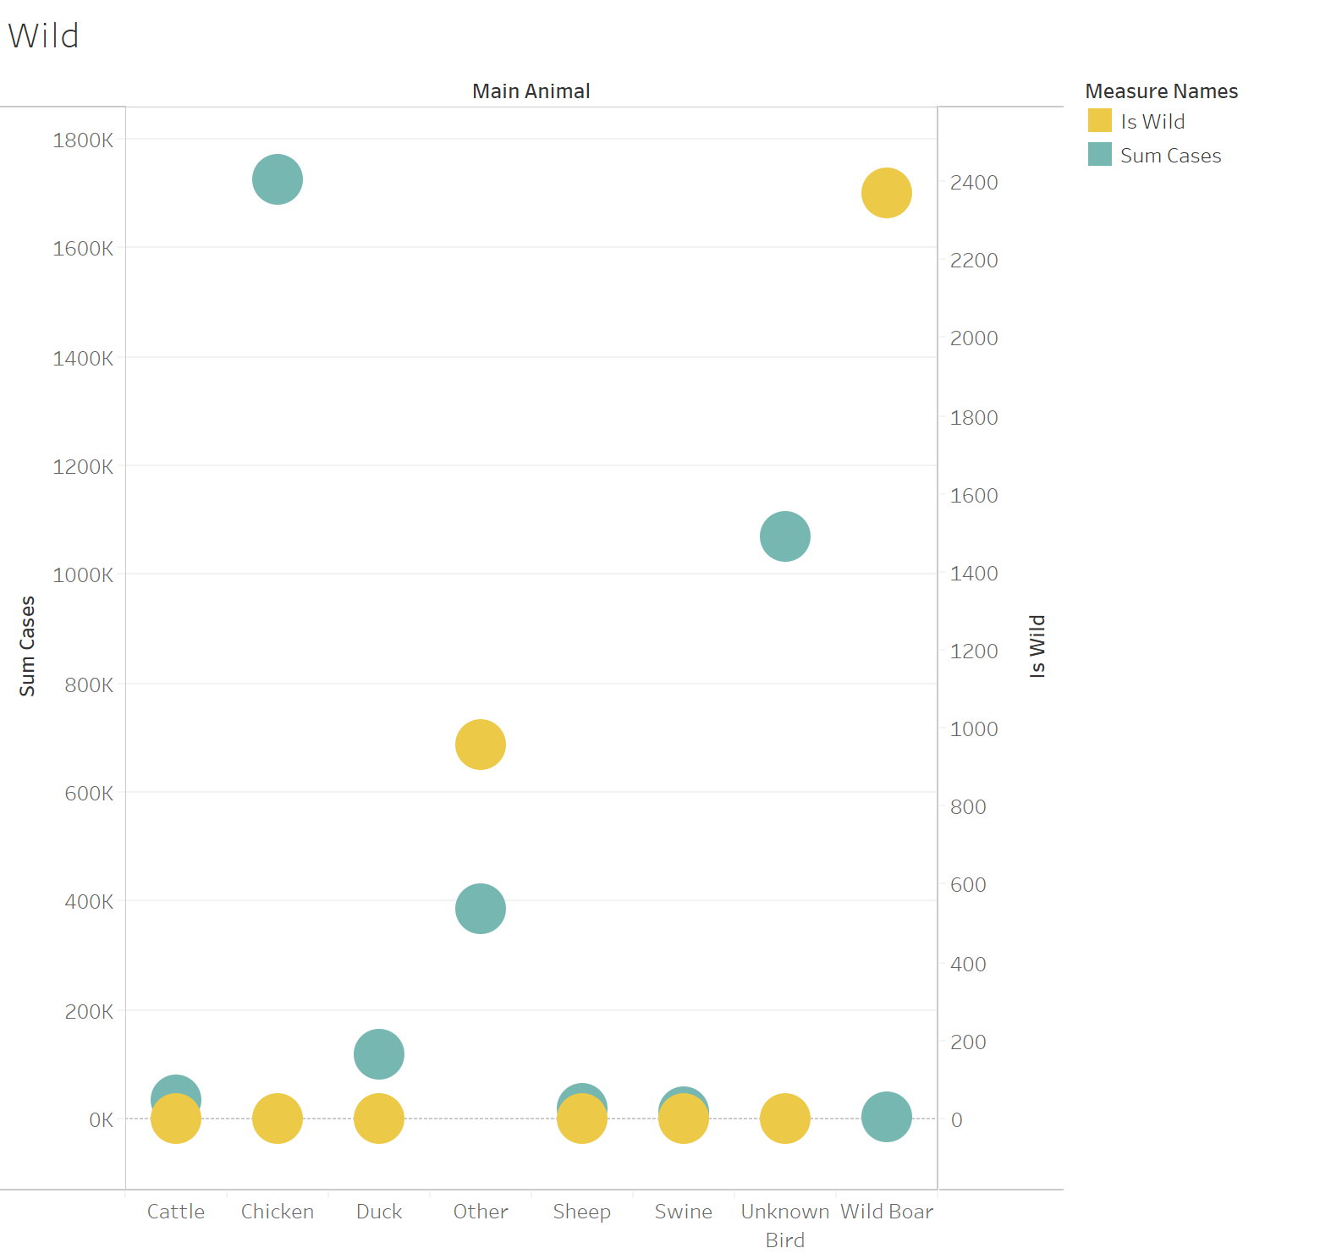
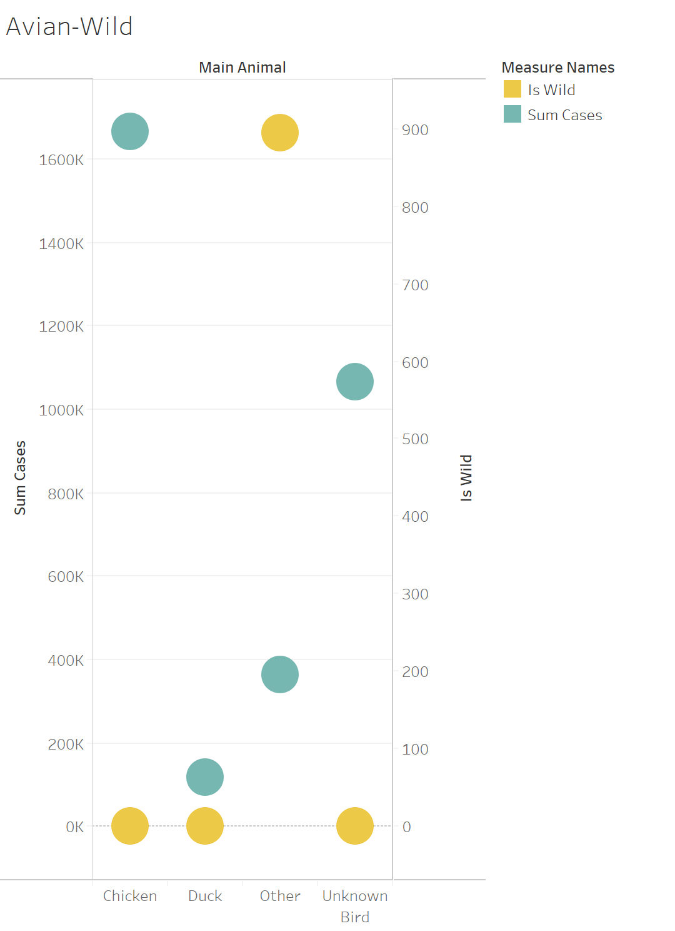
Which Animal Will Spread The Disease?

Slide 27
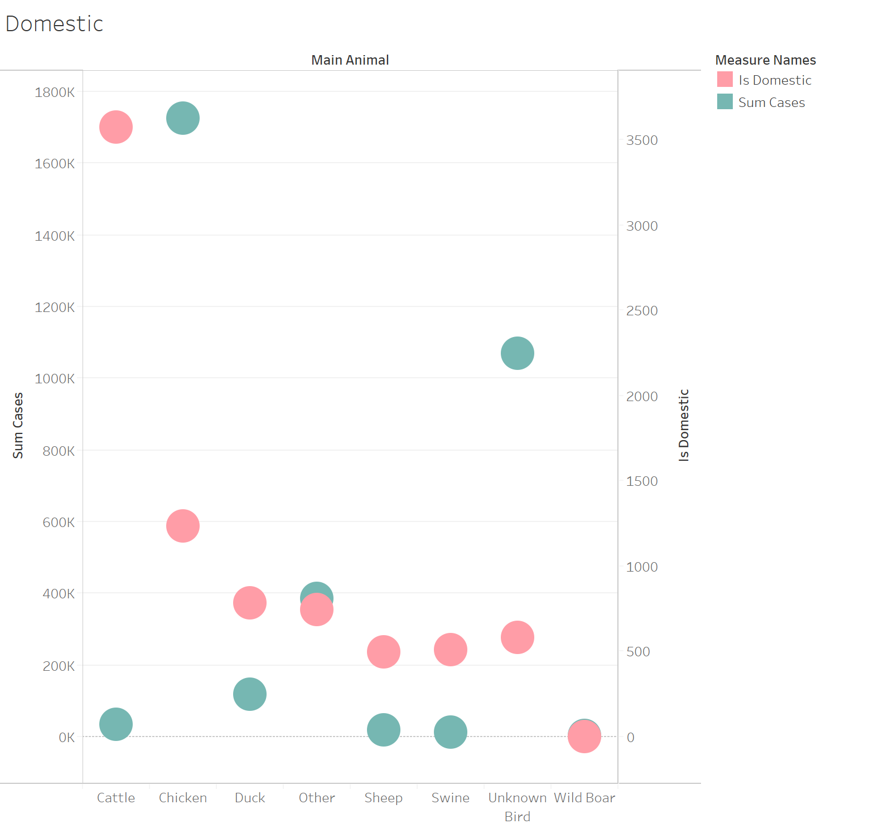
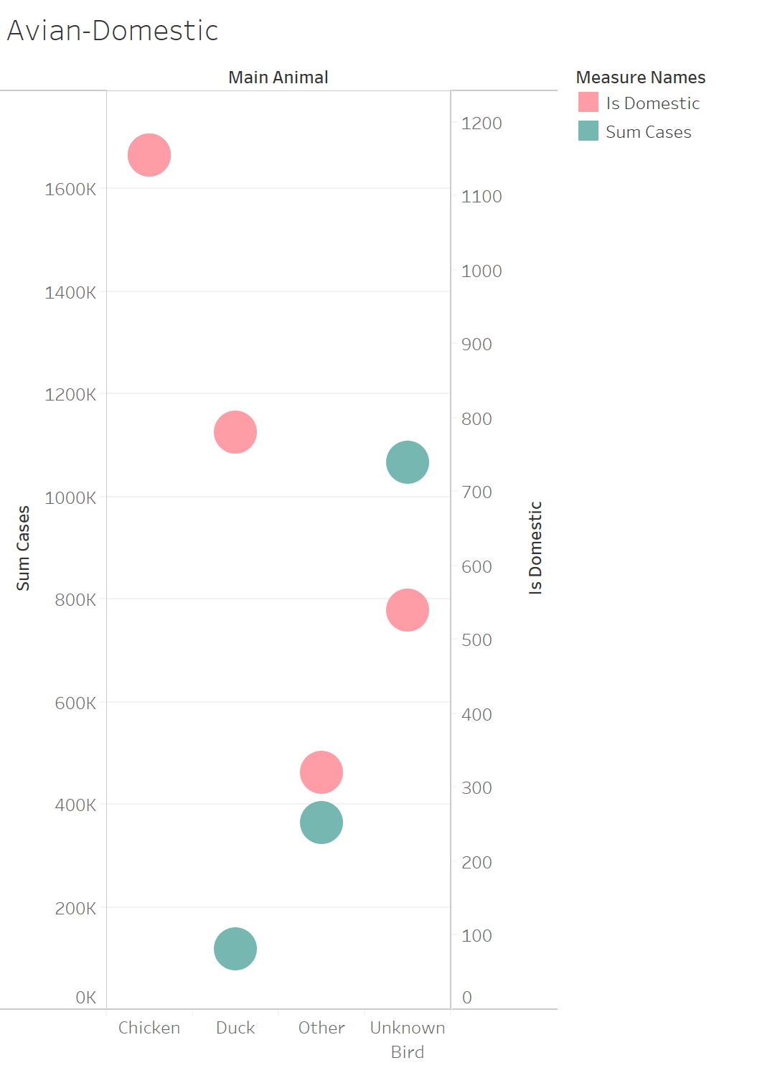
Which Animal Will Spread The Disease?

Slide 28
Other Significant Impacts
Influenza-Avian: Has disastrous agricultural and economic effects, as the disease can spread extremely quickly and cause sickness in both humans and animals.
African Swine Fever: Has huge effects on agriculture and therefore the economy.
Bluetongue Disease: Has huge effects on agriculture and therefore the economy.
Lumpy Skin Disease: Has economic losses from decreased milk production, abortions, infertility, and damaged hides. While no animals need to be killed, the disease still impacts the production yield from farm animals.

Slide 29
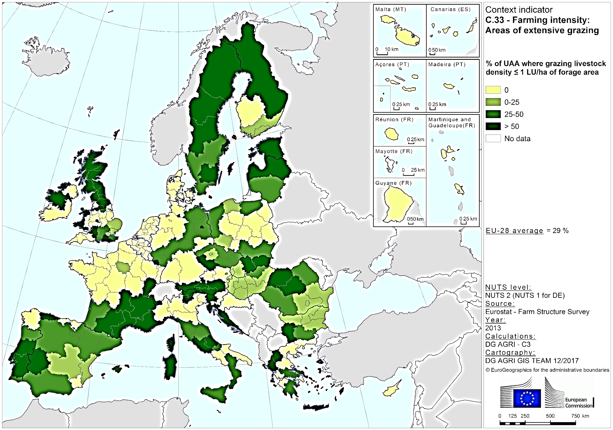
https://ec.europa.eu/agriculture/cap-indicators/context/2017_en

Slide 30
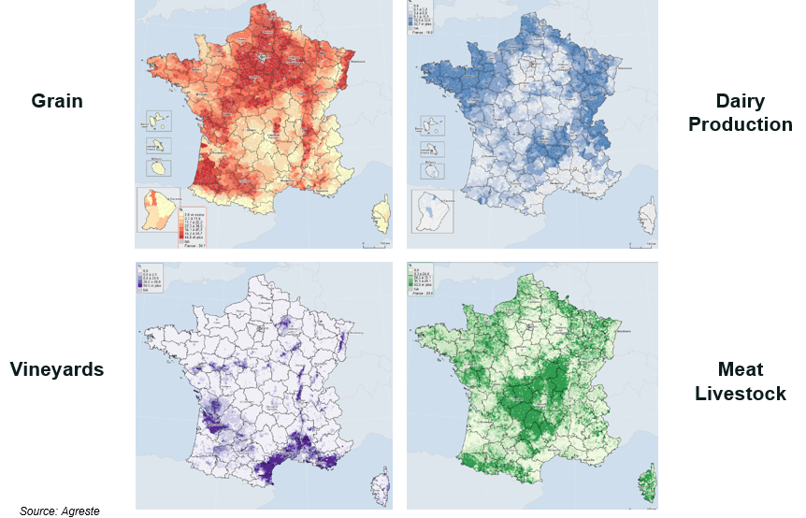
https://agriculture.gouv.fr/overview-french-agricultural-diversity

Slide 31
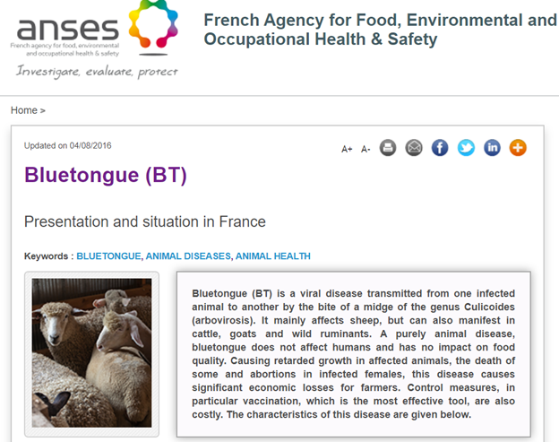
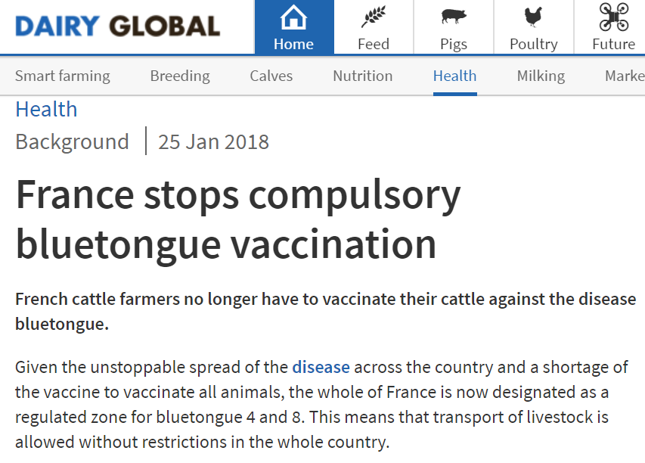
Real World Examples
https://www.dairyglobal.net/Health/Articles/2018/1/France-stops-compulsory-bluetongue-vaccination-239742E/
https://www.anses.fr/en/content/bluetongue-bt

Slide 32
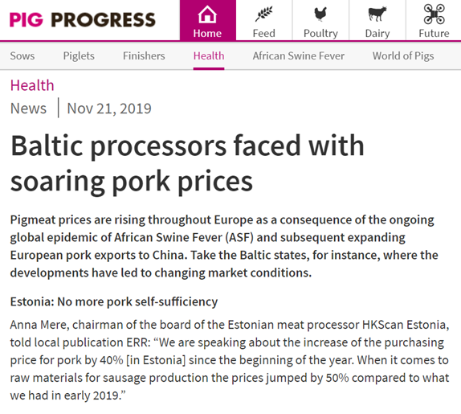
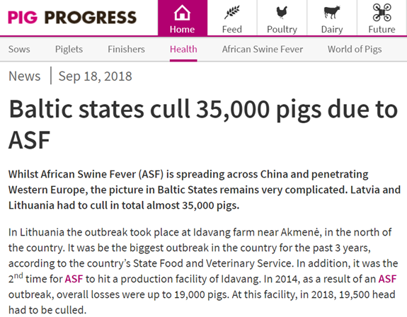
Real World Examples
https://www.pigprogress.net/Health/Articles/2018/9/Baltic-states-cull-35000-pigs-due-to-ASF-335126E/
https://www.pigprogress.net/Health/Articles/2019/11/Baltic-processors-faced-with-soaring-pork-prices-503202E/

Slide 33
Conclusion
What are the most prevalent animal diseases?
African Swine Fever, Bluetongue, Influenza-Avian, Lumpy Skin Disease (In Europe)
What countries are most at risk for these types of diseases?
France and Baltic States have highest variety
Are these diseases harmful to humans?
Influenza-Avian
Which animal (domestic, wild, or captive) poses the greatest risk of spreading these diseases?
Domestic

Slide 34
Recommendations
France and Baltic States should focus R&D to develop cheaper vaccines to recover economic losses.
Inform medical professionals, organizations and the general public of the presence, cause, and effects of these diseases.
For Farmers:
Vaccinate your animals.
If an outbreak occurs, put down all affected animals as soon as possible in order to decrease economic impact.

Slide 35
Recommendations (cont.)
Conservation Efforts
Pathogenic Research
Development of preventative measures and cures to stop outbreaks
Early identification of outbreaks of zoonotic diseases

Slide 36
Questions?

